Slide 1
Concepts in Deep Learning: Representation Learning
Luisa Abels, Laura Hellmann
Deep Leaning by Ian Goodfellow, Yoshua Bengio, Aaron Courville in 2016

Slide 2
Contents
Introduction
Transfer Learning and Domain Adaptation
Semi-Supervised Disentangling of Causal Factors
Distributed Representation
Unsupervised pretraining
Exponential Gains from Depth
Providing Clues to Discover Underlying Causes
State The Art
Further Research
Conclusion
Discussion

Slide 3
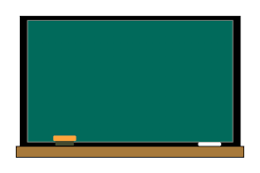
Introduction
18 -7 =
9 + 5 =
23 + 15 =
XIV + VI =
IX - III =
XXVII + XIX =
Vs.
Notes:
https://thumb.ac-illust.com/d3/d3e7899732441f8759e8fc20bfcdc6ab_t.jpeg

Slide 4
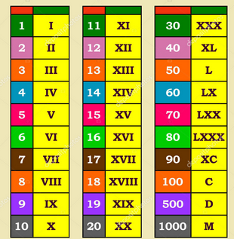
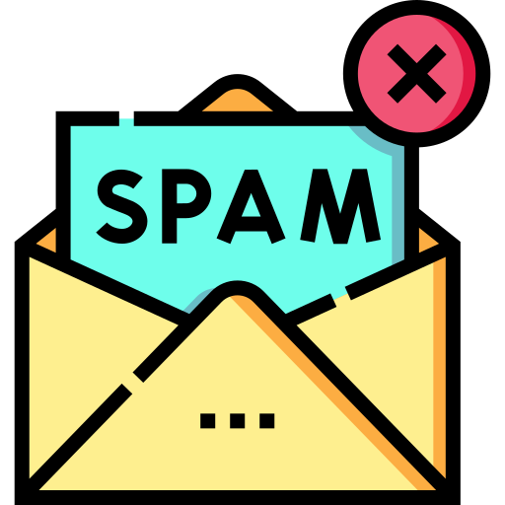
What is Representation Learning?
Everywhere in ML: with every training objective a representation is learned as a side effect
focused on finding most efficient data representation for a given task
Why is it Important?
replaced manual feature engineering
Optimized deep learning processes (e.g. faster, deeper, fewer dimensions in model)
Facilitates training with large, unlabeled datasets
Notes:
spam: https://cdn-icons-png.flaticon.com/512/9275/9275788.png

Slide 5
Deep Learning and Representations
Lower layers learn simple patterns (e.g., edges in images)
Higher layers capture complex concepts (e.g., object parts)
→ each layer of a neural network refines the data representation from simple to complex
→ each layer has a feature vector as its output
Notes:
Just a quick recap: We all know neural networks with a structure like in the picture where we have an input layer , hidden layers and an output layer. The hidden layers are our feature vectors (each node is one feature) that we want to compress into more meaningful, but abstract features. The feature vector is supposed to be the best representation od the data (features) for the intended task.

Slide 6
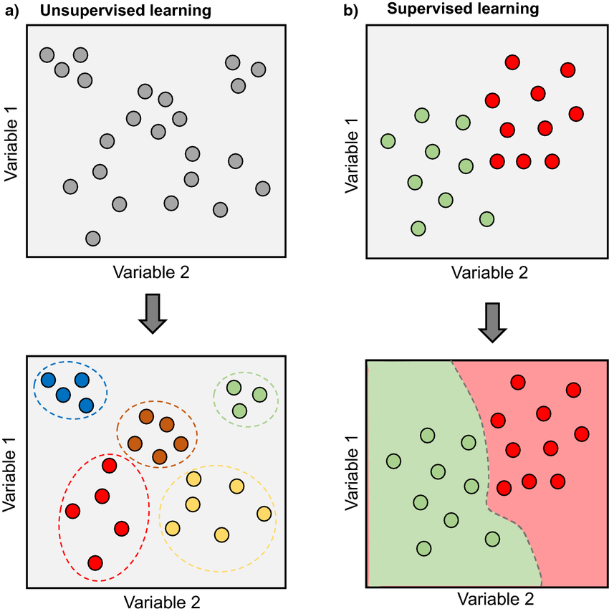
Supervised vs. Semi-Supervised vs. Unsupervised Learning
c) Semi-Supervised learning
Supervised Learning:
Guide by labeled data
Semi-Supervised Learning:
Trained with unsupervised and supervised data
Unsupervised Learning:
Finds natural patterns in data

Slide 7
Unsupervised Pretraining
Unsupervised Pretraining refers to the process of training a neural network using an unsupervised learning objective to initialize its weights before applying supervised fine-tuning. The main goal is to learn useful feature representations from unlabeled data, which serve as a better starting point for downstream supervised tasks.
Historical significance:
Enabled early deep network training without labeled data
Still used in scenarios with sparse labeled datasets
Learns structuring data before applying supervised tasks
“current” problems: overfitting; too specific parameters
Notes:
Okay, now that we

Slide 8
Greedy Layer-Wise Training
Idea: Initializing DNNs by training each layer one-by-one unsupervised and fine tuning the result with supervised learning
Input (X)
train
split
Fine-Tuning
(supervised, backpropa-gation)
Autoencoder 1
Encoder 1
(X -> H1)
Hidden Layer (H1)
Discard Decoder
train
Autoencoder 1
split
Encoder 1
(X -> H1)
Hidden Layer (H2)
Discard Decoder

Slide 9
Why Greedy Layer-Wise Training improved the Process of Training Deep Neural Networks
Two key problems were addressed
Optimization Difficulty:
Training all layers of a deep network simultaneously using backpropagation was difficult due to issues like vanishing and exploding gradients.
→ Greedy layer-wise training tackled this by training each layer independently, one at a time. This allowed each layer to learn useful features before moving on to deeper layers, making optimization more stable and effective.
Generalization:
By training each layer to produce good representations before full network training, the network could discover more useful and higher-level features.
This process acted as a form of unsupervised pretraining, which helped avoid poor local minima and improved generalization on unseen data.
Notes:
https://aiml.com/wp-content/uploads/2023/11/vanishing-and-exploding-gradient-1.png

Slide 10
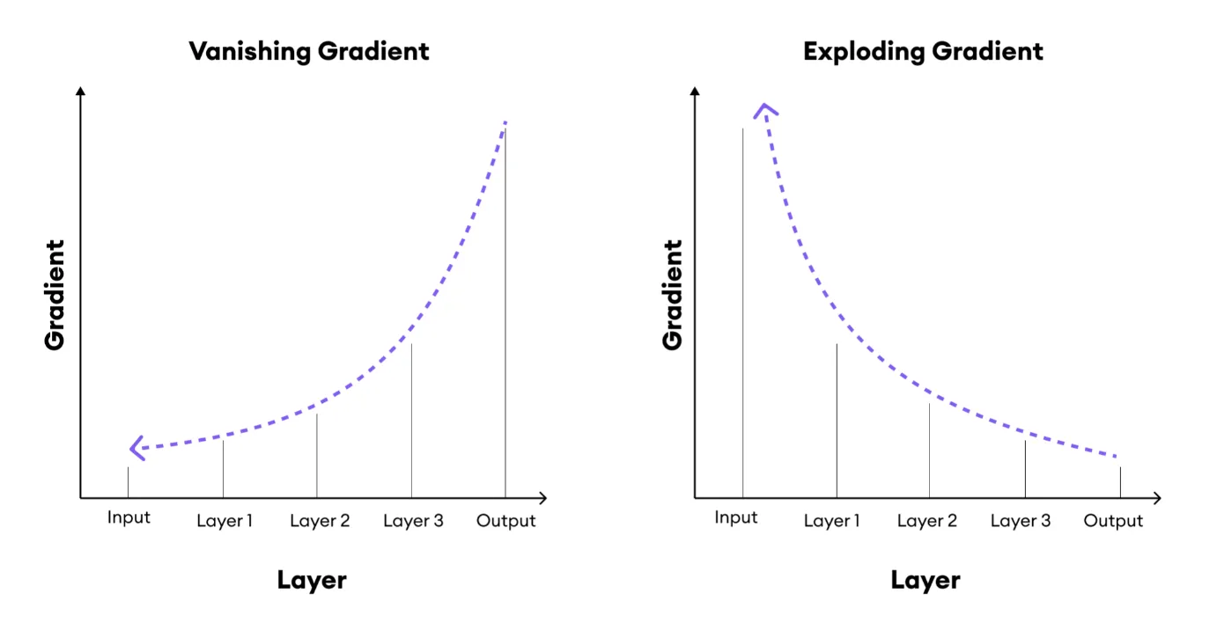
Why Greedy Layer-Wise Training improved the Process of Training Deep Neural Networks
Definition Vanishing and Exploding Gradients:
Vanishing gradients is a problem that occurs during the backpropagation step of training deep neural networks.
Vanishing Gradients: When the gradients of the loss function with respect to the weights become extremely small in earlier layers. As a result, the weights in these layers receive very little update, causing slow learning or stagnation in training.
Exploding Gradients: When the gradients become extremely large, leading to excessively large updates to the weights. This can cause the model’s parameters to diverge, resulting in instability or "exploding" loss values.
Notes:
https://aiml.com/wp-content/uploads/2023/11/vanishing-and-exploding-gradient-1.png

Slide 11
When does unsupervised Pretraining work?
Limited Labeled Data: When only small amounts of labeled data are available, but large amounts of unlabeled data exist.
Deep Architectures: When training very deep models where standard backpropagation fails due to vanishing or exploding gradients.
Feature Extraction: When the goal is to learn transferable, general-purpose feature representations that can be reused for different downstream tasks.

Slide 12
Why does unsupervised Pretraining work?
Improves Weight Initialization: Learns structured features from unlabeled data, reducing the chance of getting stuck in bad local minima.
Enables Deeper Models: Before 2006, training deep models with many layers was nearly impossible due to vanishing/exploding gradients. Unsupervised pretraining allowed the training of deeper architectures like Deep Belief Networks (DBNs).
Useful When Labeled Data Is Scarce: When labeled data is expensive or rare (e.g., healthcare, biology), unsupervised pretraining can make use of large, unlabeled datasets.
Improves Feature Learning: Learns more general, transferable features that can be reused for other downstream tasks.

Slide 13
Current Challenges
Overfitting: Since unsupervised objectives do not guarantee good generalization to the supervised task, pretraining can result in features that overfit to the pretraining task.
Specificity of Parameters: Pretraining sometimes leads to features that are too specific to the unsupervised task and may not generalize well to the supervised task.

Slide 14



Transfer Learning and Domain Adaptation
Notes:
So representation learning is all about the representation of data. Have comprised data helps reducing computing power. But another thing one can do with good representations (-> rather the features leading to a good representation for a task? So reuse the features having given good representation for a similar task) is using/adapting them for other tasks
"Imagine you’re learning to play the guitar. If you’ve never played an instrument before, it’s a slow and frustrating process. But, if you’ve already learned the piano, you can pick up the guitar much faster. Why? Because you already understand concepts like rhythm, music theory, and finger coordination. That prior knowledge 'transfers' to your new task."
This is exactly what Transfer Learning does for machine learning models. Instead of training a model from scratch, we start with a model that has already learned from a related task, speeding up learning and improving performance.
(piano: https://cdn-icons-png.flaticon.com/512/167/167161.png); (violin: https://cdn0.iconfinder.com/data/icons/luxury-services-first-class-business-vip/258/high-class-service-004-512.png); (music notes: https://as2.ftcdn.net/v2/jpg/01/99/35/85/1000_F_199358544_bZqcJe5TY942z6wEyMxqpGP6nbGsgmZ8.jpg)

Slide 15
Transfer Learning
Definition: Involves leveraging knowledge from one task or domain (distribution P1) to improve generalization in another task or domain (distribution P2).
→ Use of unsupervised datasets possible (due to training on supervised dataset with similar/shared task)

Slide 16
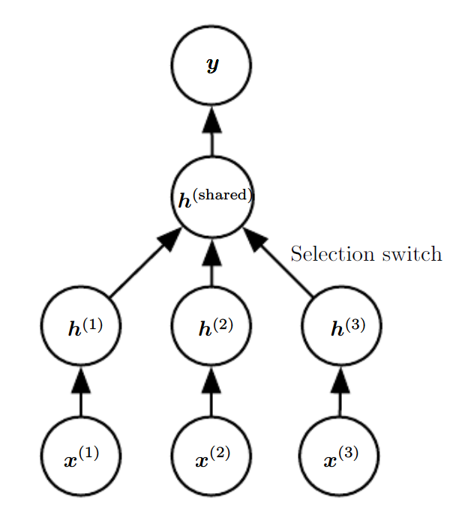
Transfer Learning
Architecture:
Task-Specific Lower Layers:
Each task x⁽¹⁾,x⁽²⁾,x⁽³⁾ has its own lower layer h⁽¹⁾,h⁽²⁾,h⁽³⁾
These layers convert task-specific inputs into a generic feature representation
Shared Upper Layers:
The shared layer h_{shared} consolidates features from all tasks
Produces a unified output y applicable to all tasks
Selection Switch:
Directs task-specific inputs to their respective processing streams before merging

Slide 17
Transfer Learning
Benefits of This Architecture
Efficiency:
By sharing higher layers, the model leverages commonalities between tasks, reducing redundancy
Scalability:
Supports multiple tasks with potentially differing input dimensions or characteristics
Transferability:
Facilitates transfer learning by applying knowledge from one task to improve performance on another

Slide 18
Transfer Learning
Applications
Personalization:
Adapting a common system to different users with unique input modalities
Multilingual systems:
Sharing core mechanics while processing language-specific inputs
Cross-domain tasks:
Applying a common decision-making layer to varied input domains

Slide 19
Domain Adaptation
Definition: A specific form of transfer learning where the task remains the same, but the input distribution changes. The model adapts to variations in data distribution across domains.

Slide 20
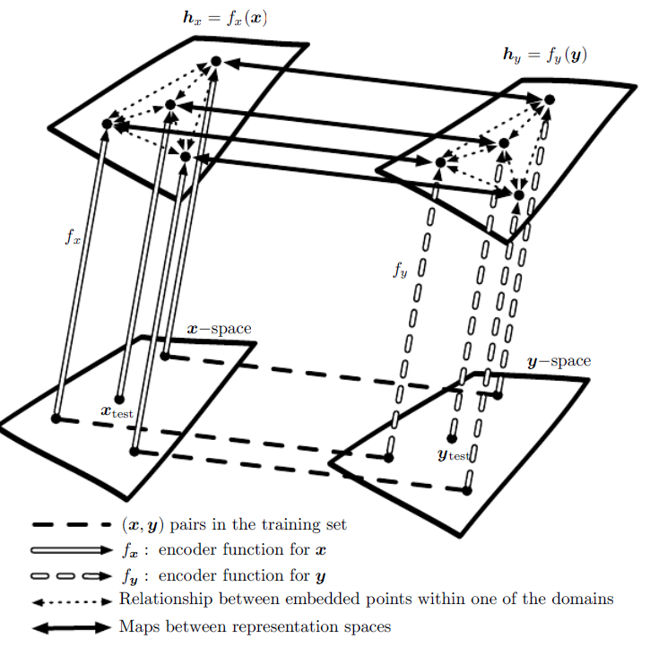
transfer learning between two domains to enable zero-shot learning
Representation Functions:
f_{x} and f_{y} are representation functions that map data from raw space (e.g., image space x and word space y) to high-level feature spaces h_{x} and h_{y}
Distance Metrics:
In h_{x} and h_{y} spaces, distances provide meaningful similarity metrics between any two points more effectively than in the raw x or y spaces
Learning Mappings:
Labeled data pairs (x,y) (dashed horizontal lines) allow learning mappings between h_{x} and h_{y} to relate representations f_{x}(x) and f_{y}(y)
Zero-Shot Learning:
Enables associating an unseen image x_{test} with a word y_{test}
Through learned mappings, even without directly seeing (x_{test}, y_{test}), their feature vectors can be related

Slide 21
transfer learning between two domains to enable zero-shot learning
Applications:
Image-Text Correspondence: Associating images with textual descriptions without direct examples
Cross-Domain Generalization: Applying knowledge from one domain to another, enhancing flexibility and reducing data reliance
Implication
approach enables flexible, powerful systems capable of generalizing to new, unseen data by leveraging relationships in learned feature spaces, facilitating advanced applications like semantic understanding across different modalities

Slide 22
Semi-Supervised Disentangling of Causal Factors
What Makes a Representation "Good"?:
Disentangled Representations: An ideal representation is hypothesized to be one where the features correspond to distinct underlying causes of the data, making it easier to understand and manipulate the representation.
Causal Factors: A representation that captures the causal factors of observations can simplify subsequent tasks, like inferring conditions or outcomes from the data.

Slide 23
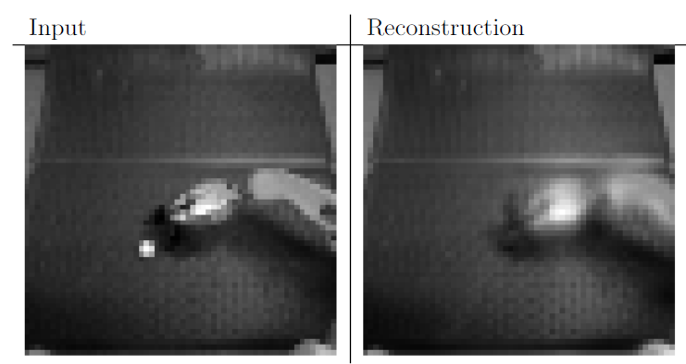
Key Challenge using Autoencoders trained with mean squared error (MSE) for Tasks requiring precise Representation of important Features:
Input Image:
Shows a scene with a robot and a visible ping pong ball (crucial element for the task at hand)
Reconstruction Output:
The autoencoder's output is missing the ping pong ball → it was not represented accurately during encoding and decoding

Slide 24
Key Challenge using Autoencoders trained with mean squared error (MSE) for Tasks requiring precise Representation of important Features:
Reasons for Failure
Saliency and Capacity:
autoencoder might have insufficient capacity to compress all features, prioritizing only considered most impactful by MSE
MSE is often less effective at capturing small but significant features to minimize average pixel-wise errors
Feature Importance:
algorithm didn't identify the ping pong ball as salient enough, showing a typical limitation when MSE is the only loss function

Slide 25
Key Challenge using Autoencoders trained with mean squared error (MSE) for Tasks requiring precise Representation of important Features:
Implications and Solutions
Task-Relevant Features:
crucial to ensure that all relevant features are encoded, which requires adaptive methods beyond simple error minimization
Potential Solutions:
Use of advanced loss functions or attention mechanisms that identify and prioritize important features
Enlarging model capacity or using regularization to focus on diverse feature representation

Slide 26
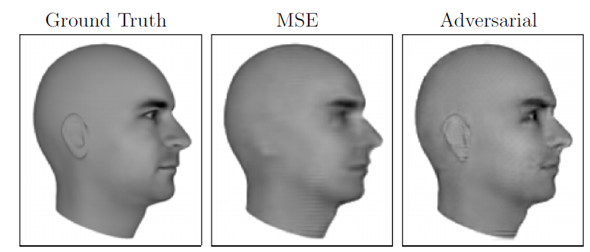
Ground Truth | Mean Squared Error (MSE) Training | Adversarial Loss Training
The correct image that the network should produce, serving as a reference for evaluating model outputs | The result of a model trained using only MSE loss Observation: Ears are not clearly represented Happens because MSE focuses on minimizing overall pixel differences, potentially ignoring subtle but important features that don't significantly affect pixel intensities | Image is generated by a model utilizing a mix of MSE and adversarial loss Observation: Ears are well-represented The adversarial component, which is typically part of Generative Adversarial Networks (GANs), helps capture finer details by learning complex patterns that MSE alone might miss

Slide 27
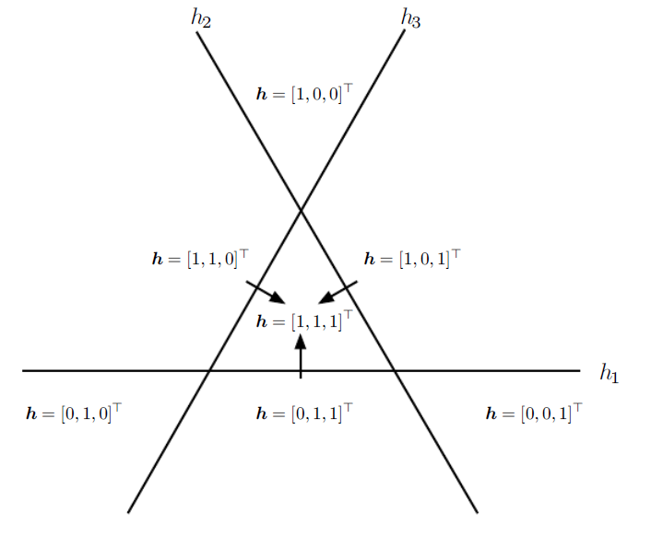
Distributed Representation
Distributed Representation:
Uses multiple binary features (e.g., h₁,h₂,h₃) to describe different regions of the input space
Each feature is activated by thresholding the output of a linear transformation → divides the space into half-planes
Input Space Partitioning:
Each feature h_{i} divides R² into two half-planes → h_{i} ⁺ and h_{i} ⁻
Overall representation space is formed by the intersection of these half-planes, giving a unique "code" for each region, e.g., [1,1,1]^{T}
Efficiency and Capacity:
With n features, the representation can distinguish O(nd) regions in R^{d} significantly more than non-distributed methods like nearest neighbors, which have linear region growth n
Despite this, a linear classifier on these representations won't assign different classes to every region due to limited capacity

Slide 28
Distributed Representation
Practical Implications:
Linearly Separable Representations: Encourages learning representations that make the classification problem easier for linear classifiers
Regularization: The capacity constraint acts as a form of regularization, focusing on essential features rather than overfitting to every possible combination
Higher-level Abstraction: Aids in learning abstract features (e.g., "person" descriptor) without needing to differentiate every small variation (e.g., "man with/without glasses")

Slide 29
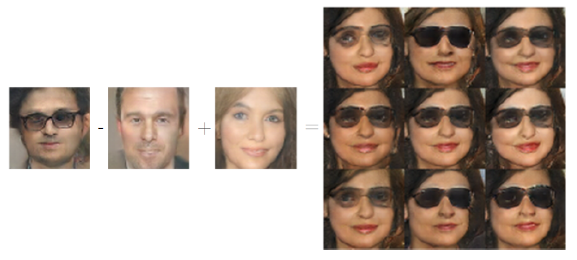
Distributed Representation
Distributed Representations:
The generative model has learned a representation space where certain high-level semantic concepts (like gender and presence of glasses) can be disentangled
Vector Arithmetic:
Start: Take the encoded representation of a "man with glasses"
Subtract: Remove the "man without glasses" representation. This effectively isolates the "glasses" component
Add: Introduce the "woman without glasses" representation, replacing the "man" component with "woman"
Result: The combination results in a "woman with glasses" representation

Slide 30
Distributed Representation
Significance:
Representation Learning: highlights the power of representation learning in capturing and manipulating high-level abstract concepts
Feature Disentanglement: ability to distinctly modify different features (gender, glasses) showcases effective disentanglement in the latent space
Applications: useful in various applications, such as style transfer, image editing, and other creative AI tasks
This approach demonstrates how abstract and human-perceivable attributes can be mathematically manipulated to achieve desired modifications in generated outputs

Slide 31
Exponential Gains from Depth
Efficiency of Deep Networks: Deep architectures can represent functions with exponentially fewer parameters than shallow networks → improved statistical efficiency, i.e., better generalization from limited data
Deep Distributed Representations: Complex relationships between abstract factors and input data (like gender and glasses presence concerning facial pixels) require deep distributed representations composed of multiple non-linear transformations → hard for shallow networks to capture due to their limited expressiveness
Exponential Gains from Depth: The composition of many non-linearities across multiple layers enables deep networks to efficiently model high-level features which are otherwise represented only with prohibitive network sizes in shallow architectures → hierarchy of feature reuse enables them to outperform shallow counterparts for certain complex functions that require extensive nonlinear combinations.

Slide 32

Providing Clues to Discover Underlying Causes
What makes one representation better than another in the context of representation learning?
Ideal Representation:
Disentanglement of Causal Factors
Effectively separates underlying causal factors responsible
for generating the observed data

Slide 33

Providing Clues to Discover Underlying Causes
Strategies for Representation Learning
Linearity: Many algorithms assume some linear relationships between variables to extend predictions far from observed data, albeit with risks of extremity.
Multiple Explanatory Factors: Suggests that solving tasks is simplified when state information of various underlying factors is known, motivating distributed representations and semi-supervised learning.
Causal Factors: Encourages models to treat learned representations as causes of data, enhancing robustness under changing distributions or tasks.
Depth or Hierarchical Structure: Uses deep architectures to capture abstract concepts via hierarchies, indicative of using multiple processing stages to solve tasks.
Smoothness: Assumes that small changes in input lead to small changes in output, promoting generalization to nearby points.

Slide 34
Providing Clues to Discover Underlying Causes
Strategies for Representation Learning
Shared Factors Across Tasks: Advocates for shared representations across tasks for statistical strength, crucial when tasks overlap in underlying causal factors.
Manifolds: Suggests probability mass concentrates in lower-dimensional structures, with many ML algorithms attempting to model or exploit these manifolds.
Natural Clustering: Assumes data clusters or manifolds often correspond to a single class, motivating manifold learning techniques.
Temporal and Spatial Coherence: Assumes underlying factors change slowly and are easier to predict than raw data, inspiring techniques like slow feature analysis.
Sparsity: Imposes the idea that few features should be active for any given input, reducing complexity by focusing on relevant features.
Simplicity of Factor Dependencies: Good representations simplify dependencies between factors, often striving for independence or linear relationships.

Slide 35
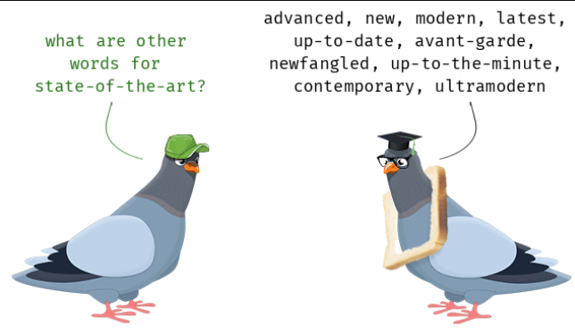
State of the Art
Deep Generative Models:
GANs (Generative Adversarial Networks): Capable of generating high-quality images (variations like StyleGAN and BigGAN)
VAEs (Variational Autoencoders): Useful for unsupervised learning and anomaly detection
Self-Supervised Learning:
Contrastive Learning: Methods like SimCLR and MoCo can leverage unlabeled data efficiently
Masked Image Modeling: Techniques such as MAE for visual representation learning
Transformers:
Vision Transformers (ViTs): Apply transformer models beyond text to achieve state-of-the-art performance in vision applications
Multimodal Models: Integration of text, vision, and audio for richer representation, e.g., CLIP and DALL-E

Slide 36

Further/Future Research
Scalable and Efficient Models:
Reducing model size and computational requirements without sacrificing performance
Federated learning to enhance privacy while training models on distributed data
Causal Representation Learning:
Developing models that learn representations capturing causal relationships, improving robustness and interpretability
Ethical and Fair AI:
Addressing biases in learned representations and ensuring fairness
Unsupervised and Few-Shot Learning:
Improving techniques for learning from limited data without extensive labeling
Augmenting Human Abilities:
Enhancing human decision-making and creativity with AI models that can learn highly abstract and complex representations

Slide 37
Conclusions
Core Idea: Representation Learning is about learning better, more useful representations of data to make machine learning tasks easier, faster, and more effective. Instead of manually crafting features, models learn them automatically from raw data.
Breakthrough for Deep Learning: It was a key reason deep learning became successful, allowing for the training of deeper networks while solving challenges like vanishing gradients.
Broad Applicability: Representation learning is everywhere — from image recognition to natural language processing (NLP) to reinforcement learning. It powers modern AI models like large language models (LLMs) and vision transformers (ViTs).
Improves Generalization: By learning features directly from data, models generalize better to unseen tasks and domains, which is critical for applications like healthcare, robotics, and autonomous vehicles
Still important
Future Possibilities

Slide 38
Discussion
Do

Slide 39
References

